Slide 1
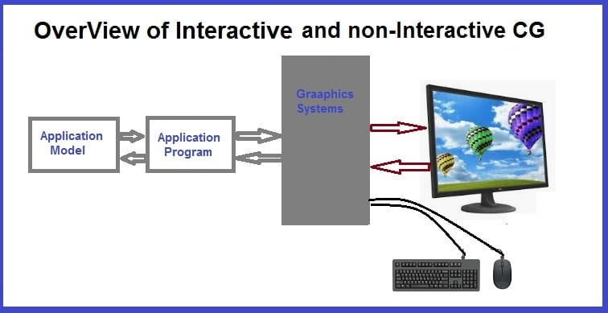
Types of Computer Graphics

Slide 2
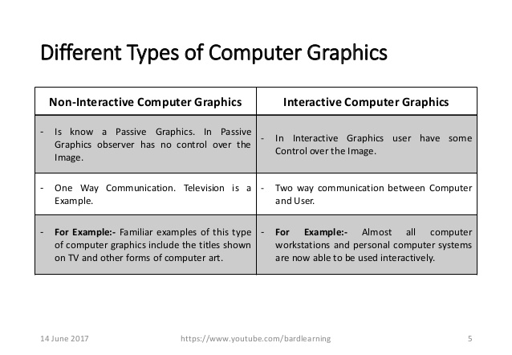

Slide 3

Applications of Computer Graphics
Computer Art:

Slide 4
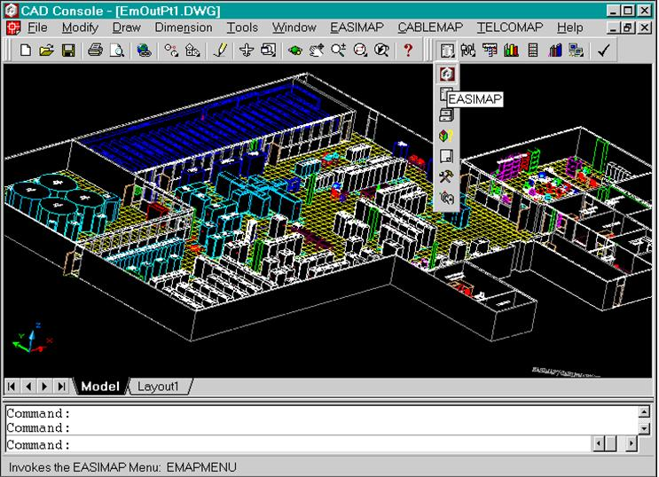
Computer Aided Drawing:

Slide 5

Presentation Graphics:

Slide 6

Entertainment:

Slide 7

Education:

Slide 8
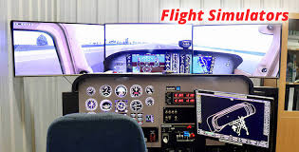
Training:

Slide 9

Visualization:

Slide 10

Image Processing

Slide 11
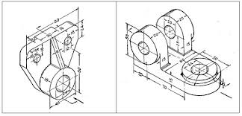

Machine Drawing:

Slide 12
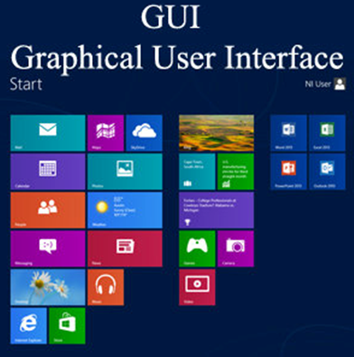

Slide 13
CONCLUSION
In this lecture we studied what is computer graphics and it can be broadly classified into two categories Interactive and non-interactive computer graphics. Role of computer graphics in various fields such as education, entertainment, medical, training , visualization etc. and also it’s advantages. https://youtu.be/5ThMSq4feDU

Slide 14
QUESTIONS
Q.1. Define Computer Graphics. Differentiate between Interactive and Non-Interactive computer graphics?
Q.2. Explain the working of Interactive computer graphics.
Q.3. What are the advantages of computer graphics?
Q.4. Write in detail about the various fields where computer graphics is used.
Q.5. What is a frame buffer?

